Slide 1
INVENTORY MANAGEMENT SYSTEM

Slide 2
INTRODUCTION
An “INVENTORY” is the stock of item kept to meet future demand.
This project was developed using Java language ,Netbeans IDE and database used for the project was MongoDB.
It will generate a report in the system which will help the user to check the status of the equipment in laboratory .
It used databases concept to store all the information which related to the stock that which types of products we have in this system and these products are stored.
This system focused updating the data. Reports produced in the system make easier to check the status of the equipments present in various laboratories.
Besides this system is a further development of conventional method using forms which were used before.
It use database to store all the information, which is related to the lab equipments.

Slide 3
DEVELOPMENT TOOLS
TOOLS USED
Platform | Windows
Operating System | Windows 7/8/8.1
Front End Tool | Core JAVA(Netbeans)
Back End Tool | MongoDB

Slide 4
DEVELOPMENT TOOLS(CONTD.)
Netbeans is a software development platform written in Java. The Netbeans Platform allows applications to be developed from a set of modular software components called modules. Application based on the Netbeans Platform, including the Netbeans integrated development environment(IDE),can be extended by third party developers.
MongoDB is a cross-platform document oriented. Classified as a NoSQL database, MongoDB eschews the traditional table-based relational database structure, making the integration of data in certain types of applications easier and faster.

Slide 5
MODULES OF PROJECT
LOGIN MODULE
HOME PAGE
INVENTORY MODULES :-
ENTER STOCK
ISSUE STOCK
ALLOCATION MODULES :-
ALLOTMENT
REQUIREMENT

Slide 6
REPORT MODULES :-
LAB WISE REPORT
MONTHLY REPORT
YEARLY REPORT
CHANGE PASSWORD MODULE

Slide 7
LOGIN MODULE
Login form is the first form of the project.
This form is added to restrict unauthorized users from accessing the sensitive data.
Only authorized users will be able to access the application.

Slide 8
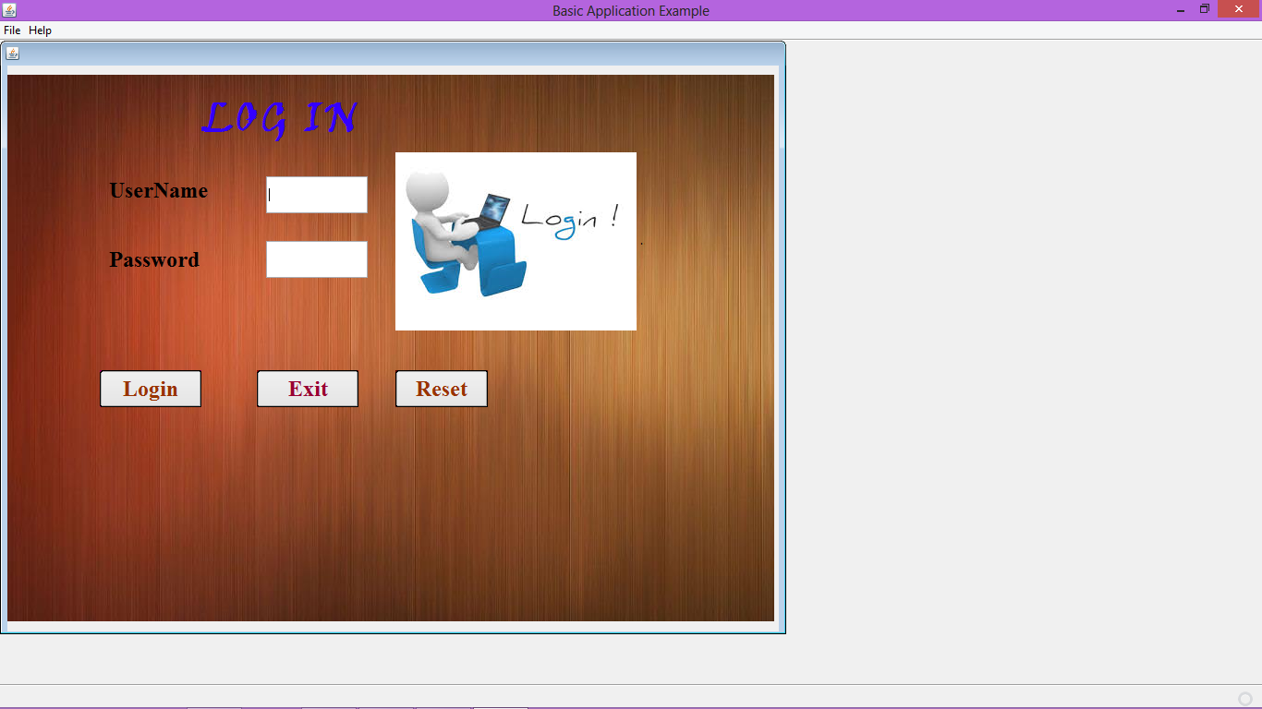

Slide 9
HOME PAGE
This form opens when the user’s authentication is successfully completed.
This form provides the user to access all the other modules.
This form is the main form. When we press the home button from any other module, we again enter in this form again.

Slide 10
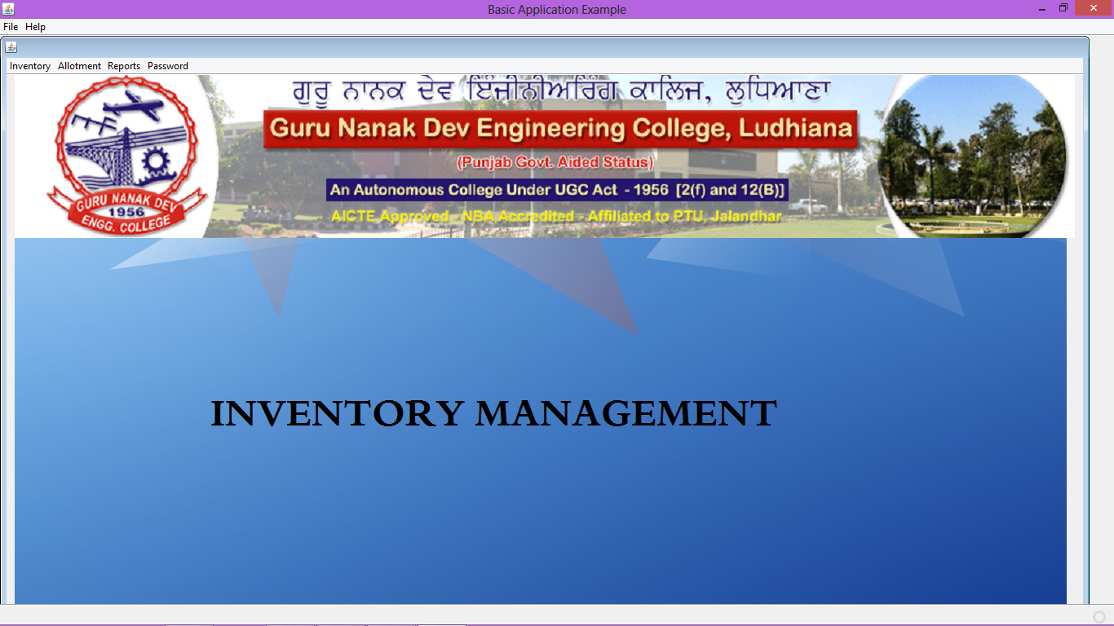

Slide 11
ENTER STOCK
This form is used to enter the details of newly purchased equipments into the database.
This form is also used to update the details of previously purchased equipments by searching the model no of the equipment.

Slide 12
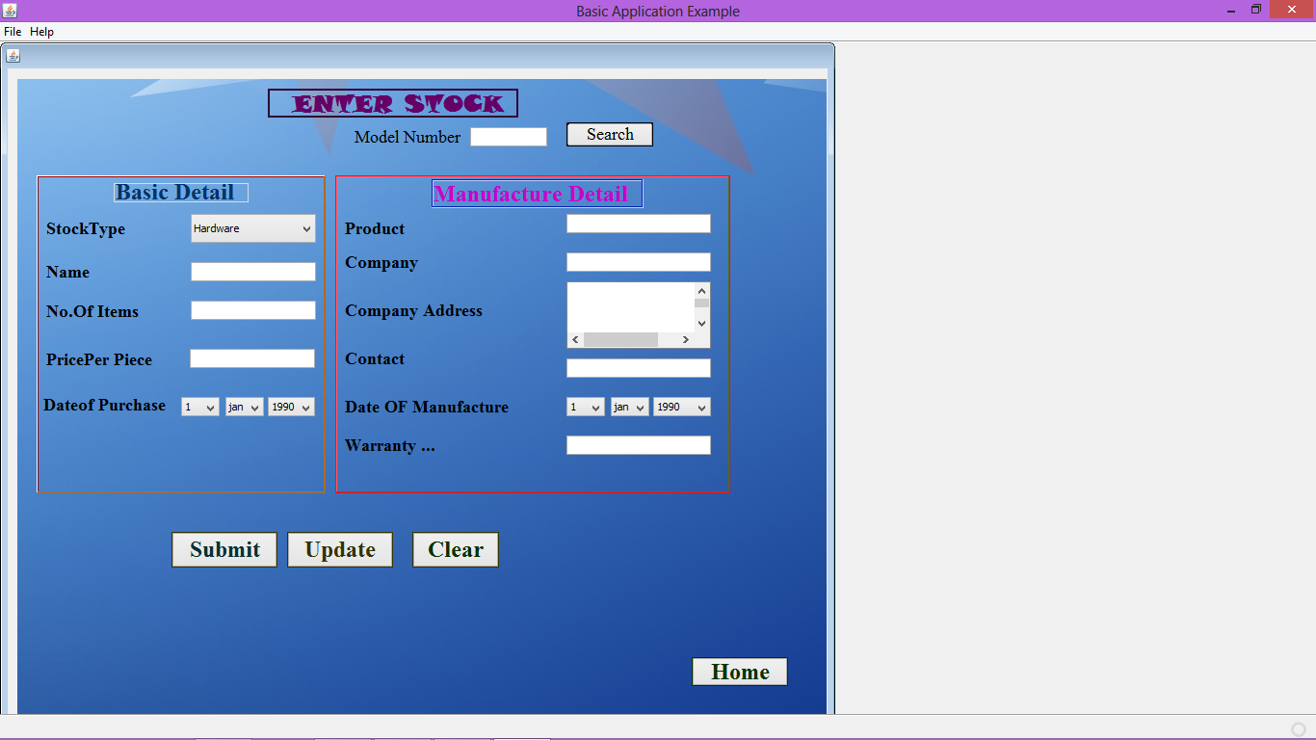

Slide 13
ISSUE STOCK
This form is used to issue the newly purchased equipments to a particular laboratory of a specific department.

Slide 14
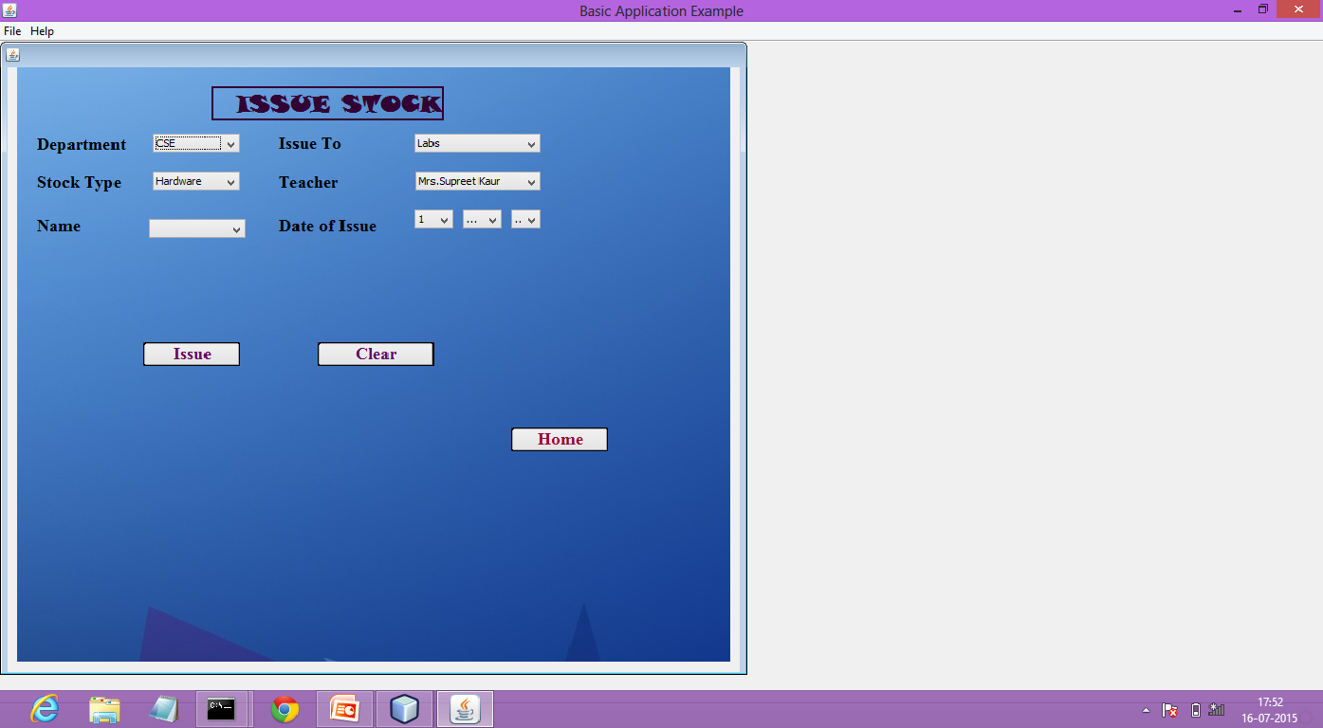

Slide 15
ALLOTMENT
This form is used to allocate the various type of equipments to a particular laboratory according to the requirement.

Slide 16
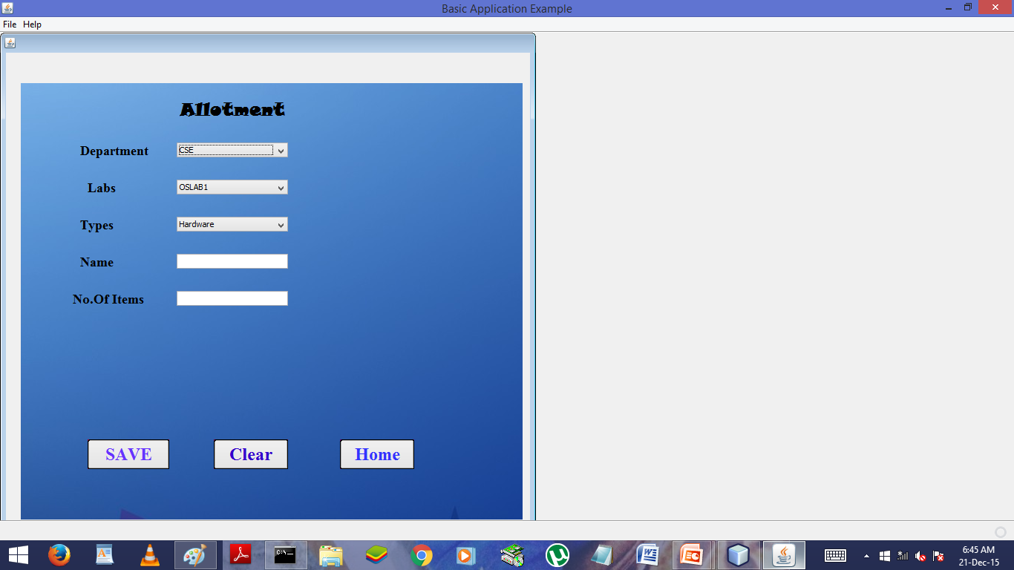

Slide 17
REQUIREMENT
This form is used to display the list of equipments required for a particular department of a particular stock type.
This form is used to print the list of equipments required for a particular department of a particular stock type.

Slide 18
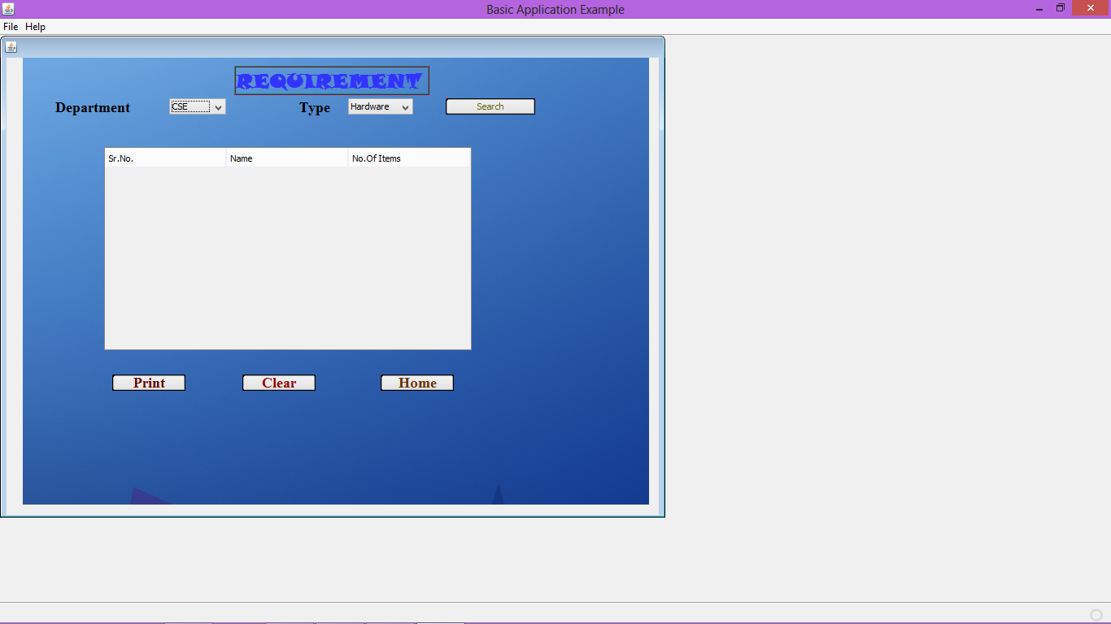

Slide 19
LAB WISE REPORT
This form is used to display the list of equipments and their details present in a particular laboratory in the form of a table.
This form is used to print the list of equipments and their details present in a particular laboratory.

Slide 20
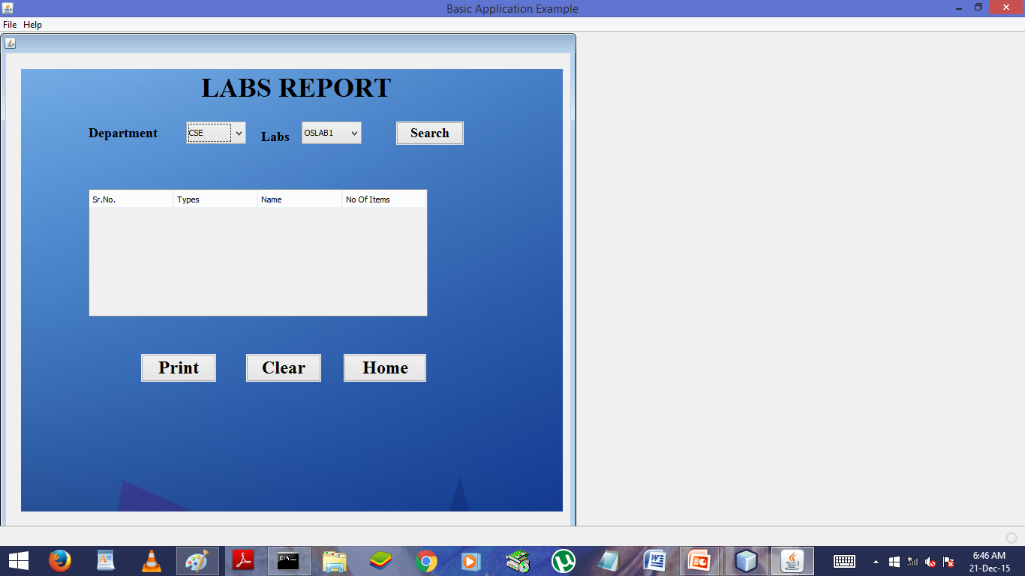

Slide 21
MONTHLY REPORT
This form is used to display the list of all the equipments purchased during a particular month of a specific year in the form of a table.
This form is used to print the list of equipments and their details purchased during a particular month of a specific year .

Slide 22
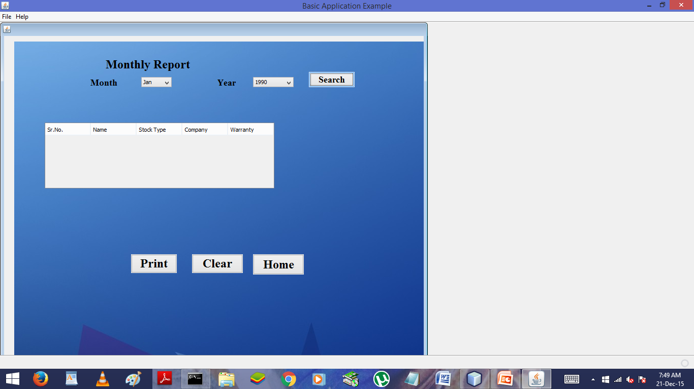

Slide 23
YEARLY REPORT
This form is used to display the list of all the equipments purchased during a particular year in the form of a table.
This form is used to print the list of equipments and their details purchased during a particular month of a specific year .

Slide 24
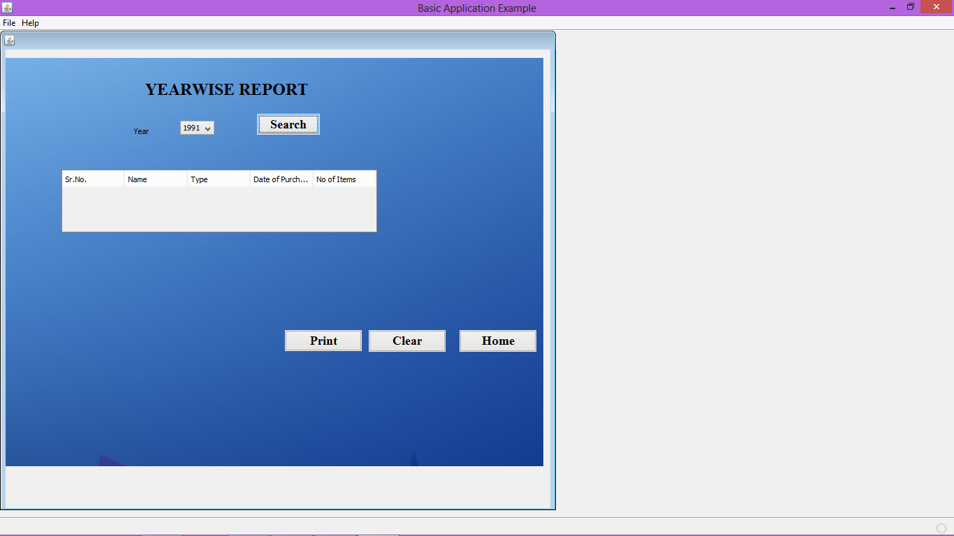

Slide 25
CHANGE PASSWORD
This form is used to change the password of the account.

Slide 26
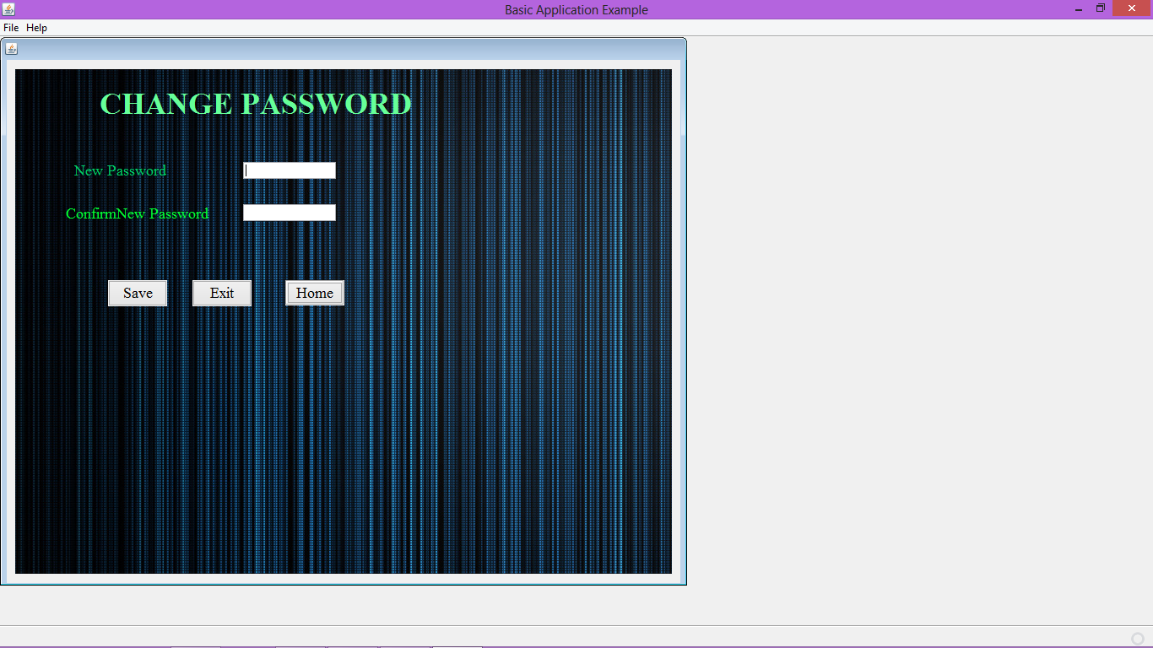

Slide 27
SUBMITTED TO :- PROF. SUKHJIT SINGH SEHRA
SUBMITTED BY :-
SNEHDEEP KAUR
1410982
D3 CSE(E3)

Slide 28
THANKS....

